Slide 1
final project presentation
By: Brandon Cocanig
12/12/19

Slide 2
My website layout structure
Notes:
1872 lines of code
11 functional pages
2 database tables

Slide 3
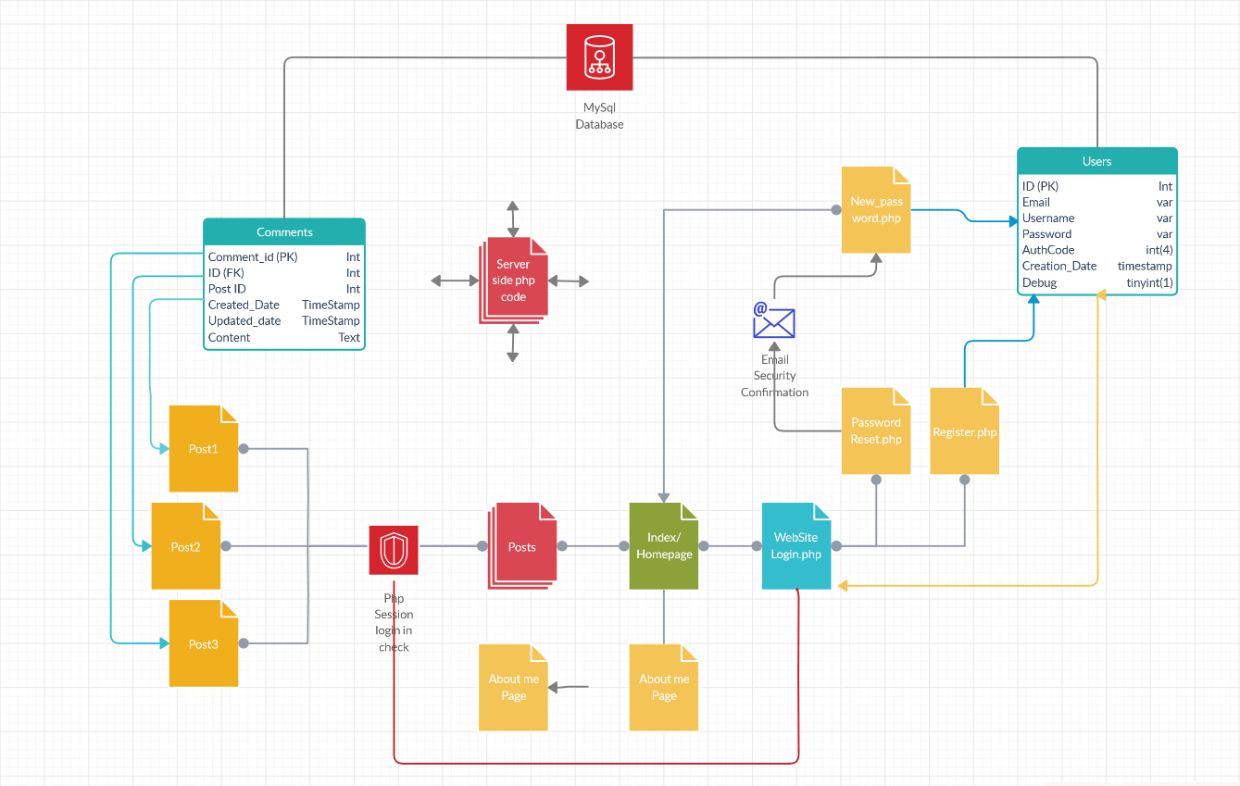

Slide 4
XAMPP

Slide 5
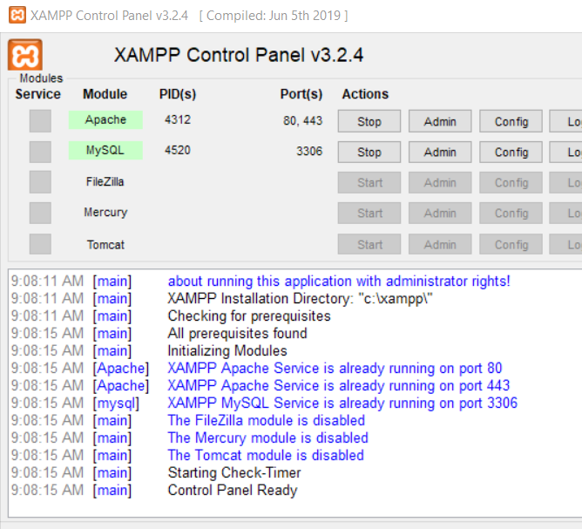
Features
XAMPP is a free and open-source cross-platform web server solution. Developed by Apache.
XAMPP, it makes transitioning from a local test server to a live server possible.
XAMPP stands for:
Cross-Platform (X), Apache (A), MariaDB (M), PHP (P) and Perl (P).

Slide 6
SQL injection Offence
Incorrectly filtered escape characters
Blind SQL injection

Slide 7
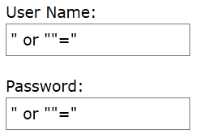
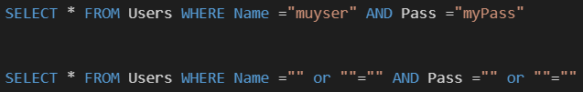
SQL injection example

Slide 8
SQL injection Mitigation
Detection
Parameterized statements
Pattern check
Database permissions

Slide 9
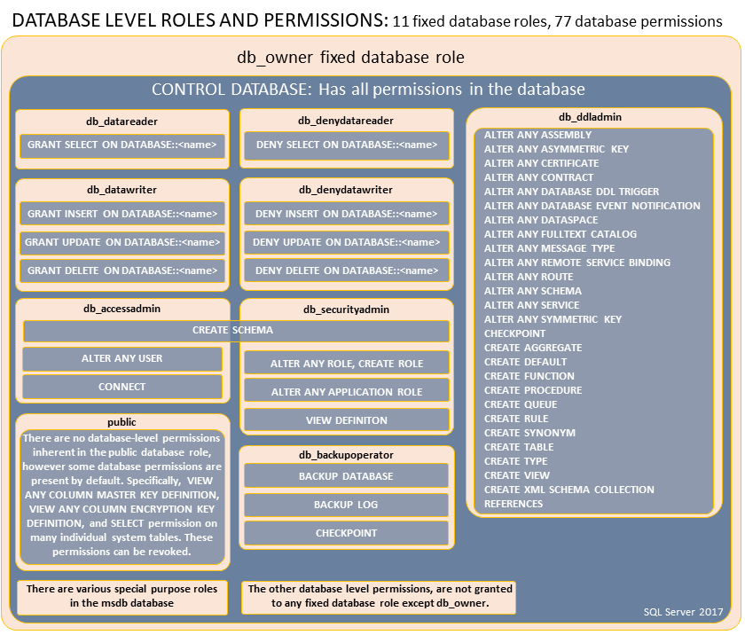
Database permissions

Slide 10
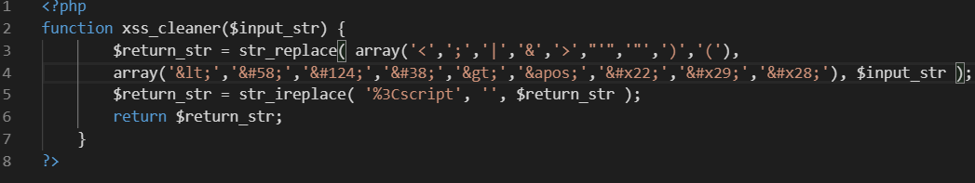
Remove the ability to use special chars in my code

Slide 11
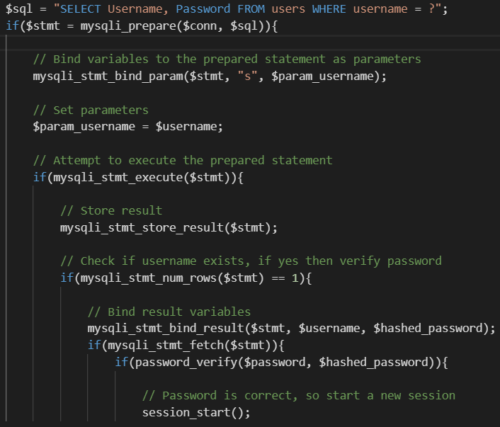
Parameterized statements

Slide 12
phpMyAdmin
phpMyAdmin is a free software tool written in PHP, intended to handle the administration of MySQL over the Web. phpMyAdmin supports a wide range of operations on MySQL

Slide 13
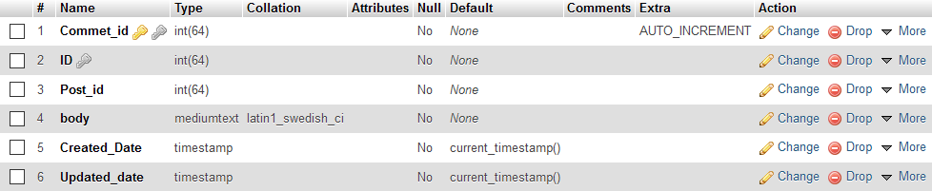
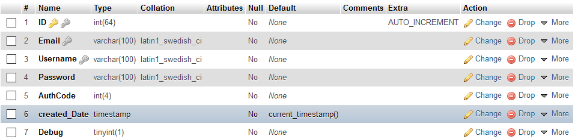
Table structure

Slide 14
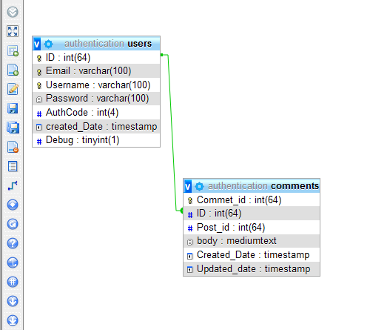
Foreign keyed connections

Slide 15
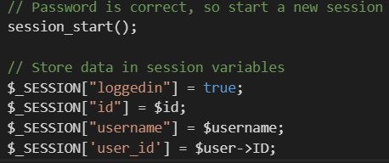
Creating Php sessions
Session variables are set with the PHP global variable: $_SESSION.

Slide 16
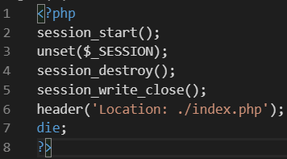
destroying Php sessions
removes all global session variables and destroy the session

Slide 17

Conclusion
Questions?

